Slide 1
Model Persistence and Pipelines
Serialize | restore | pipelines | automate

Slide 2
Story so far… and more
Understanding the Requirements (think about a few logical parameters required)
Understanding the data available (identify the gaps)
Data Preparation
(EDA, missing values, outliers, feature engineering, scaling etc.)
Define data type
Train Test Split
Train & tune the model (hyperparameter tuning)
Test / Validate
Saving the model
Automate the pipeline
Deploy (API)
Refurbish

Slide 3
Saving the model (to persist the model)
Serialization is a good idea for testing / comparing our models
This process / procedure of saving a ML Model is also known as object serialization - representing an object with a stream of bytes, in order to store it on disk, send it over a network or save to a database
Similarly when you restore the model, it is called deserialization or restoring the model

Slide 4
3 ways to save your model
Pickle Approach
Joblib Approach
Manual Save and Restore to JSON approach

Slide 5
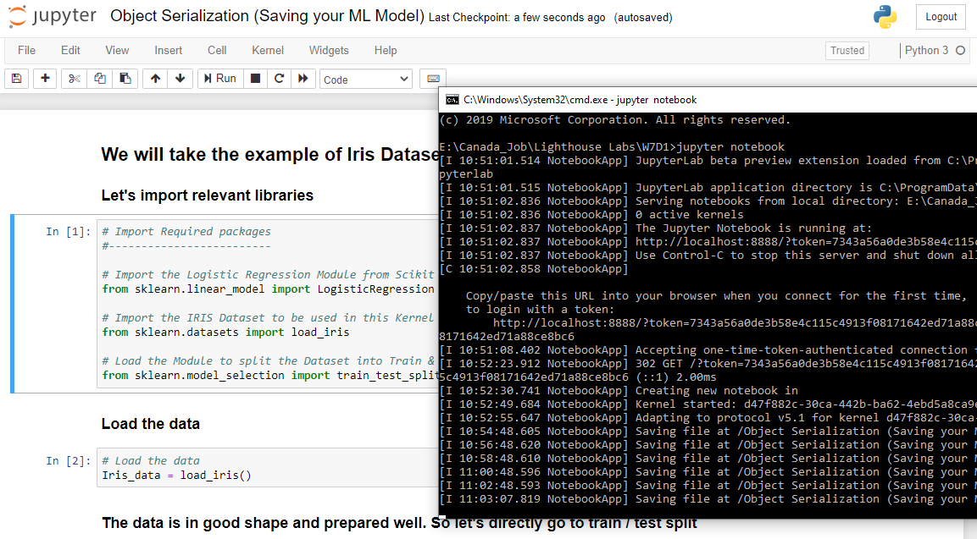
Let’s go to Jupyter

Slide 6
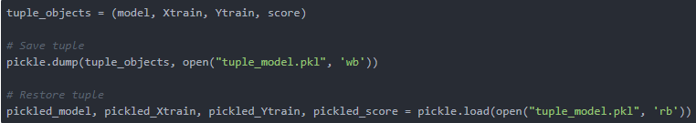
Pros and Cons of Pickle
PROs:
Save and restore our learning models is quick - we can do it in two lines of code.
It is useful if you have optimized the model's parameters on the training data, so you don't need to repeat this step again.
CONs:
It doesn't save the test results or any data. Still you can do this by saving a tuple, or a list, of multiple objects (and remember which object goes where), as follows:

Slide 7
Joblib
The Joblib Module is available from Scikit Learn package
It is intended to be a replacement for Pickle, for objects containing large data
This approach will save our ML Model in the pickle format only but we don’t need to load additional libraries as the 'Pickling' facility is available within Scikit Learn package itself which we will use invariably for developing our ML models.

Slide 8
Let’s go to Jupyter

Slide 9
Advantages of Joblib
The Joblib library offers a bit simpler workflow compared to Pickle.
While Pickle requires a file object to be passed as an argument, Joblib works with both file objects and string filenames.
In case our model contains large arrays of data, each array will be stored in a separate file, but the save and restore procedure will remain the same.
Joblib also allows different compression methods, such as 'zlib', 'gzip', 'bz2', and different levels of compression. MongoDB malfunctions if model is > 16MB size. AWS S3 has unlimited space.

Slide 10
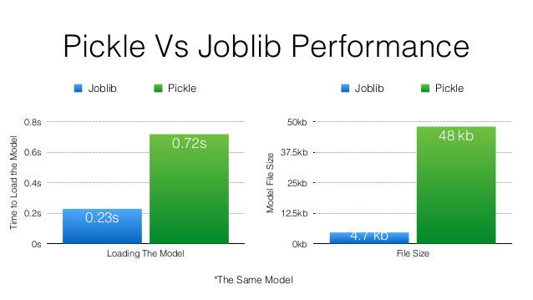
Pickle Vs. Joblib

Slide 11
Try for yourself
Import libraries
Create a large array of Numpy zeros to keep it simple
Compare the save and restore times of both Pickle and Joblib
Now compare with and without flattening

Slide 12
Manual approach

Slide 13
Advantages
PROs :
Since the data serialization using JSON actually saves the object into a string format, rather than byte stream, the 'mylogreg.json' file could be opened and modified with a text editor.
CONs :
Although this approach would be convenient for the developer, it is less secure since an intruder can view and amend the content of the JSON file.
Moreover, this approach is more suitable for objects with small number of instance variables, such as the scikit-learn models, because any addition of new variables requires changes in the save and restore methods.

Slide 14
When to choose Pickle vs. Joblib
Joblib is usually significantly faster on large numpy arrays because it has a special handling for the array buffers of the numpy data structure. It can also compress that data on the fly while pickling using zlib or lz4.
Joblib also makes it possible to memory map the data buffer of an uncompressed joblib-pickled numpy array when loading it which makes it possible to share memory between processes.
If you don't pickle large numpy arrays, then regular pickle can be significantly faster, especially on large collections of small python objects (e.g. a large dict of str objects) because the pickle module of the standard library is implemented in C while joblib is pure python.
Since PEP 574 (Pickle protocol 5) has been merged in Python 3.8, it is now much more efficient (memory-wise and cpu-wise) to pickle large numpy arrays using the standard library. Large arrays in this context means 4GB or more.
But joblib can still be useful with Python 3.8 to load objects that have nested numpy arrays in memory mapped mode with mmap_mode="r".

Slide 15
More Reading
https://medium.com/fintechexplained/how-to-save-trained-machine-learning-models-649c3ad1c018

Slide 16
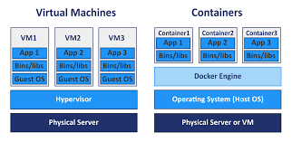
Caveat!
Serialization depends on the current version of object (Python version, sklearn version)
Solution:
Dockers
Virtual Environments
Sandbox
Kubeflow

Slide 17
What about security?
pickle (and joblib by extension), has some issues regarding maintainability and security. Because of this,
Never unpickle untrusted data as it could lead to malicious code being executed upon loading.
While models saved using one version of scikit-learn might load in other versions, this is entirely unsupported and inadvisable. It should also be kept in mind that operations performed on such data could give different and unexpected results.

Slide 18
Limitations
In order to rebuild a similar model with future versions of scikit-learn, additional metadata should be saved along the pickled model:
The training data, e.g. a reference to an immutable snapshot
The python source code used to generate the model
The versions of scikit-learn and its dependencies
The cross validation score obtained on the training data
This should make it possible to check that the cross-validation score is in the same range as before.
Since a model internal representation may be different on two different architectures, dumping a model on one architecture and loading it on another architecture is not supported.

Slide 19
Your decisions
Readymade solutions (Freelancers)
Custom Solutions (outsourcing)
Customer Solutions (in-house)
Readymade platforms (Click and Play) (Data Robot, Sagemaker etc.)

Slide 20
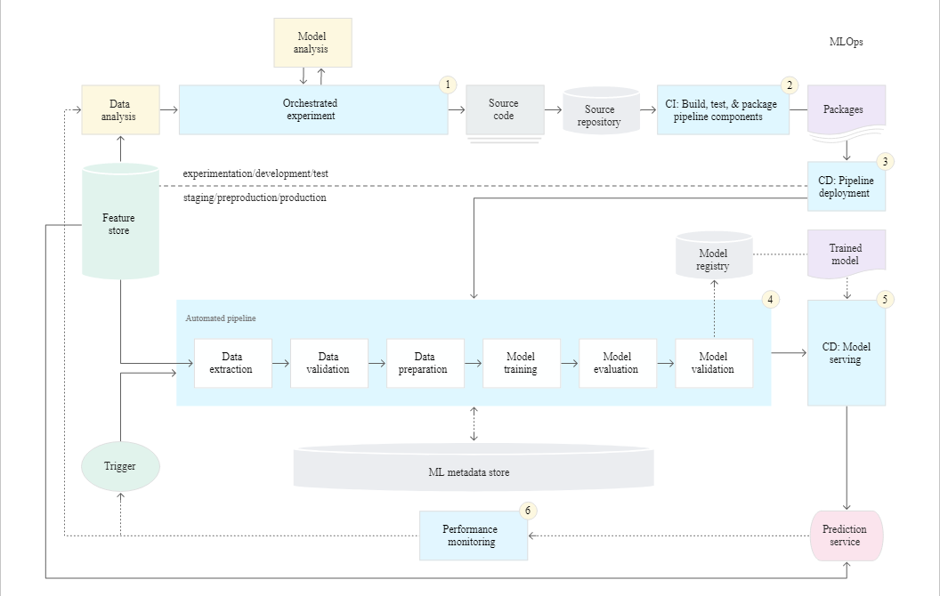

Slide 21
Before we dive in
Estimators: Any objects that can estimate some parameters based on a dataset is called an estimator. The estimation itself is performed by calling fit() method.
This method takes one parameter (or two in case of supervised learning algorithms). Any other parameter needed to guide the estimation process is called hyperparameter and must be set as in instance variable. For example: I would like to estimate a mean, median or most frequent value of a column in my dataset.
Transformers: Transform a dataset. It transforms a dataset by calling transform() method and it returns a transformed dataset. Some estimators can also transform a dataset. For example: Imputer class in sklearn is an estimator and a transformer. You can call fit_transform() method that estimate and transform a dataset.
https://scikit-learn.org/stable/tutorial/machine_learning_map/

Slide 22
What is a pipeline?
Sequentially apply a list of transforms and a final estimator. Intermediate steps of pipeline must implement fit and transform methods and the final estimator only needs to implement fit.

Slide 23
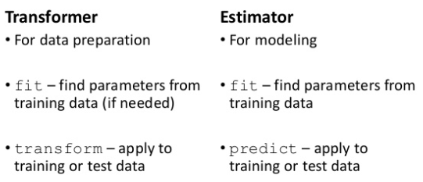
Let’s take a closer look

Slide 24
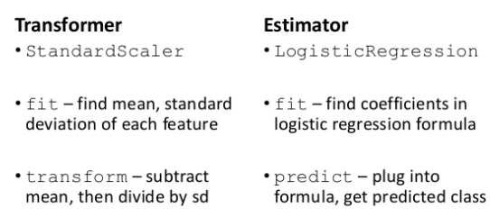
And?

Slide 25
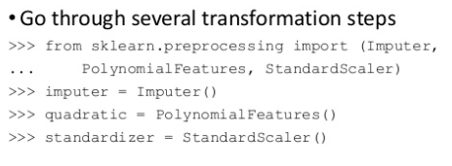
Multiple Transformations

Slide 26
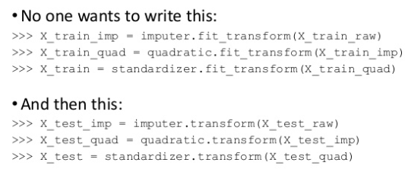
Tedious!

Slide 27
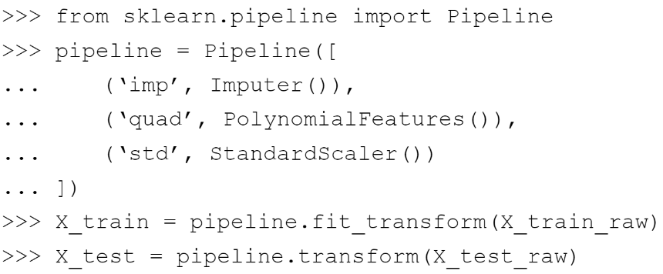
Enter Pipelines!

Slide 28
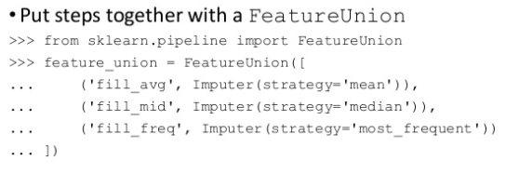
Different imputations together

Slide 29
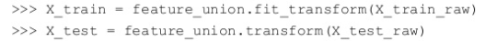
And just write this …

Slide 30
What else?
Use function transformer to create any function into a transformer
Write your own custom transformer

Slide 31
From a bird’s eye view
Training
Testing/Production
Load data
Load new data
Almost identical workflow
labels + plain text
plain text
Extract features
Extract features
labels + feature vectors
feature vectors
Train model
Predict using model
labels + predictions
predictions
Evaluate
Act on predictions

Slide 32
This is a problem
Training
Load data
Pain point
labels + plain text
Parameter tuning
Key part of ML
Involves training many models
For different splits of the data
For different sets of parameters
Extract features
labels + feature vectors
Train model
labels + predictions
Evaluate

Slide 33
Enter …
Pipelines!

Slide 34
More Reading
https://scikit-learn.org/stable/modules/compose.html

Slide 35
Hands on
https://medium.com/vickdata/a-simple-guide-to-scikit-learn-pipelines-4ac0d974bdcf
https://www.geeksforgeeks.org/pipelines-python-and-scikit-learn/
https://dzone.com/articles/how-to-build-a-simple-machine-learning-pipeline
https://towardsdatascience.com/a-simple-example-of-pipeline-in-machine-learning-with-scikit-learn-e726ffbb6976
https://www.guru99.com/scikit-learn-tutorial.html
https://scikit-learn.org/stable/tutorial/statistical_inference/putting_together.html

Slide 36
Create specific pipelines
Pipelines for
Regression
Classification
Cross Validation
Feature Engineering
All of them!

Slide 37
Questions?
Thank you!

